Slide 1

✈ TRAVEL & BOOKING
IXIGO
Automation Testing — Wipro Capstone Project
TEAM MEMBERS
1. Telukuntla Sindhu
2. Hariharan M
3. Punya Pratiksha Sahoo
4. Himanshu Gupta
5. Trisha Nandi
6. Pramithi Pal
Wipro | Domain: Travel & Booking | Platform: Ixigo
Notes:
1

Slide 2
Team & Module Overview
#
Member
Module
Framework
Tests / Pass
# | Member | Module | Framework | Tests / Pass
1 | Telukuntla Sindhu | Hotel Booking | Selenium PyTest + BDD | 7 / 7
2 | Hariharan M | Trip Planner | Selenium PyTest + BDD | 7 / 7
3 | Punya Pratiksha Sahoo | Flight Booking | Selenium PyTest + BDD | 7 / 7
4 | Himanshu Gupta | Train Booking | Selenium PyTest + BDD | 7 / 7
5 | Trisha Nandi | Vande Bharat Train Booking | Selenium PyTest + BDD | 7 / 7
6 | Pramithi Pal | Bus Booking | Selenium PyTest + BDD | 7 / 7
Wipro | Domain: Travel & Booking | Platform: Ixigo
Notes:
2

Slide 3



Telukuntla Sindhu
Selenium PyTest + BDD
Ixigo Hotel Booking
MODULE OVERVIEW
Automates the end-to-end hotel booking workflow: login, destination search, hotel search, filter application, room reservation, guest detail entry, and payment validation.
Positive Tests Executed
Negative Tests Executed
.
.
.
Hotel Search: Validated dynamic destination search using auto-suggestions.
Invail Payment: Verified system error handling for insufficient card digits.
Empty Details: Ensured validation triggers when mandatory guest fields are left blank.
.
.
Filter Validation: Verified successful application of the "Free Breakfast" filter.
.
Guest Details: Automated dynamic data entry from external CSV to the reservation form.
Payment Flow: Verified processing of correct Credit/Debit card details.
7
7
0
100%
Total Tests
Passed
Failed
Accuracy
Notes:
2

Slide 4

Hariharan M
Selenium PyTest + BDD
Ixigo Trip Planner — Selenium PyTest + BDD
MODULE OVERVIEW
Automates the ixigo Trip Planner module: travel month selection, origin city entry, filter selection, tourist location navigation, Google Maps verification, and flight booking workflow.
Positive Tests Executed
Negative Tests Executed
.
.
.
Plan Navigation: Validated successful loading and routing of planner module URLs.
Invalid Location: Verified the "no results found" error message displays correctly.
Book Now Button: Ensured the booking button remains hidden for unsupported routes.
.
.
Month Selection: Automated dynamic travel month input driven by Excel data.
.
Filter Application: Validated results for "International" & "Pollution Free" tags.
Location Card: Verified successful navigation to specific tourist destination pages.
7
7
0
100%
Total Tests
Passed
Failed
Accuracy
Notes:
3

Slide 5

Punya Pratiksha Sahoo
Selenium PyTest + BDD
Ixigo Flight Booking
MODULE OVERVIEW
Automates the ixigo flight booking path: search validation, result filtering/sorting, booking flow, traveller details, add-ons, seat selection, and payment page.
Positive Tests Executed
Negative Tests Executed
.
.
.
Search & Filter: Validated flight result loading, non-stop filtering, and price sorting.
Same Route: Ensured search is blocked when source and destination are identical.
Missing Input: Ensured search is blocked when the destination field is omitted.
.
.
Booking Navigation: Handled cancellation prompts and validated URL states.
.
Traveller Entry: Automated form filling using external CSV data sets.
Add-ons & Payment: Verified the seat selection process and payment page routing.
7
7
0
100%
Total Tests
Passed
Failed
Accuracy
Notes:
4

Slide 6

Himanshu Gupta
Selenium PyTest + BDD
Ixigo Train Booking
MODULE OVERVIEW
Automates the ixigo train booking journey: OTP-based login, dynamic train search with source/destination/date from Excel, available seat selection, passenger details, and payment page validation.
Positive Tests Executed
Negative Tests Executed
.
.
.
Valid Login: Automated handling of OTP-based login verification.
Invalid Station: Ensured the booking process stops with invalid station data.
Empty Passenger: Verified the system blocks saving passenger details without a name.
.
.
Train Search: Validated dynamic station and travel date search inputs.
.
Seat Booking: Automated the selection of available train seats.
Passenger Flow & Payment Flow: Verified the end-to-end journey to the payment confirmation page.
7
7
0
100%
Total Tests
Passed
Failed
Accuracy
Notes:
5

Slide 7

Trisha Nandi
Selenium PyTest + BDD
Vande Bharat Express Train Booking
MODULE OVERVIEW
Automates the ixigo train booking journey: OTP-based login, direct navigation to filter Vande Bharat Express routes, future calendar date and seat inventory selection, dynamic passenger details injection from Excel, and secure payment page layout validation.
Positive Tests Executed
Negative Tests Executed
.
.
.
Login Button: Login button visible successfully.
Invalid Mobile Number: Message displayed for invalid mobile number.
Empty Mobile Number: Ensured validation triggers when the mobile number field is left empty.
.
.
Valid Mobile Number Entry: Mobile number accepted successfully.
.
Continue Button: Continue button works properly.
Complete Login Flow: Login completed successfully.
7
7
0
100%
Total Tests
Passed
Failed
Accuracy
Notes:
6

Slide 8

Pramithi Pal
Selenium PyTest + BDD
Ixigo Bus Booking
MODULE OVERVIEW
Automates the ixigo Buses module: login, bus navigation, source/destination entry, travel date selection, bus search, filter application, seat selection, passenger details, and payment page verification.
Positive Tests Executed
Negative Tests Executed
.
.
.
Bus Search: Validated source, destination, and travel date entry functionality.
Invalid City: Verified application error handling for unsupported or fake locations.
No Availability: Verified that unavailable/grayed-out seats cannot be selected or booked.
.
.
Filter Selection: Verified application of AC, Sleeper, and Departure Time filters.
.
Seat Selection: Automated navigation of the seat layout and selection of available seats.
Payment Navigation: Validated passenger detail entry and proper routing to checkout.
7
7
0
100%
Total Tests
Passed
Failed
Accuracy
Notes:
7

Slide 9
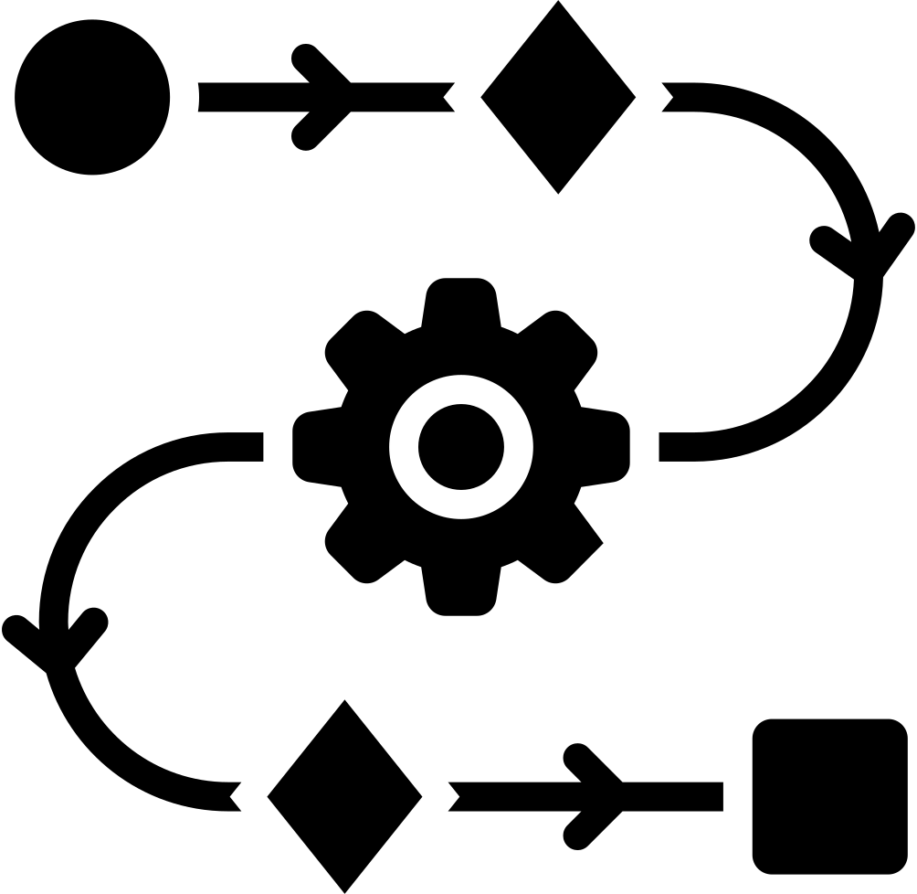





DELIVERABLES
What we built and tested
AUTOMATION FRAMEWORK
TEST COVERAGE
Selenium WebDriver + PyTest + Behave BDD with Page Object Model (POM) architecture
End-to-End, Positive & Negative test cases across all team modules (100% pass rate)
ALLURE REPORTS
SCREENSHOT EVIDENCE
Professional HTML reports with step-by-step execution flow, screenshots & history
Automated screenshot capture at each key execution stage for audit & debugging
EXECUTION LOGS
GITHUB REPOSITORY
Detailed Python logging for execution tracking and failure diagnosis, the log reports were made.
Full codebase with README, feature files, page objects, and data files version-controlled
Notes:
8

Slide 10
THANK YOU
Wipro Capstone Project • Ixigo Automation Testing
Sindhu • Hariharan M • Pratiksha • Himanshu Gupta • Trisha • Pramithi
Domain: Travel & Booking | Platform: Ixigo | Organization: Wipro
Notes:
9

